Slide 1
Control Theory
By Davis Shapiro

Slide 2
What is Control Theory?
In simple terms, Control Theory is the field of robotics that uses mathematics, physics, and other areas to manipulate the pose of a robot.
Pose = the position and rotation of an object

Slide 3
Terms
Pose – the position and rotation of an object
Controller – code that moves our robot in a specific way
Sensor – something that gets data for the robot to use
Error – the difference between where you want to be and where you are currently.
Closed-loop controller – a type of controller that uses sensors to correct the robot’s position/pose
Open-loop controller – a type of controller that does not use sensors to correct the robot’s position/pose

Slide 4

Open-Loop Controllers
Open-loop controllers are simple in concept, and you may have worked with them before without realizing it. They’re useful in predictable environments where you don’t have to worry about your robot “slipping” or encountering obstacles. Open-loop controllers can be faster than other types of controllers, but they aren’t great in VEX due to the nature of the game (there are other unpredictable robots).
For example, telling your robot to “drive forward for 5 seconds” is an example of an open-loop controller, since the robot isn’t using any sensors to help it move.

Slide 5
A simple Open-Loop Controller
Challenge: make a simple open-loop controller that drives the robot forward for a certain number of seconds, then stops. Use a function!
When you finish, you should be able to type “<your function name>(<any number of seconds here>);” and the robot should drive forward for that number of seconds. For example, “move_forward(5);” should drive forward for 5 seconds.
To spin the motors: <motor name>.spin(fwd);
To stop the motors: <motor name>.stop();
To delay: wait(x, sec);

Slide 6

Code Reading Check!
I’ll assign numbers 1, 2, and 3 randomly.

Slide 7
#1
void turn lint deg) {
break;
}

Slide 8
#2
int x = 4;
if (x == 4) {
wait(1, sec);
}

Slide 9
#3

Slide 10
A Simple Closed-Loop Controller
In VEX, an effective autonomous program requires precise movement. We’ll write a simple controller that moves the robot to a target and stops when it gets there.

Slide 11
How?
VEX Motors come with rotation sensors in them called “encoders”. These encoders return the current rotation of the motor, and we can use them to tell how close we are to our goal.

Slide 12
Steps
Let’s develop a plan for building this controller.
Get the current position of our motor
Get the “error” by subtracting the goal from the current position
Move the robot forward until we reach the target, then exit
Wait… what happens if the target is behind our robot?

Slide 13
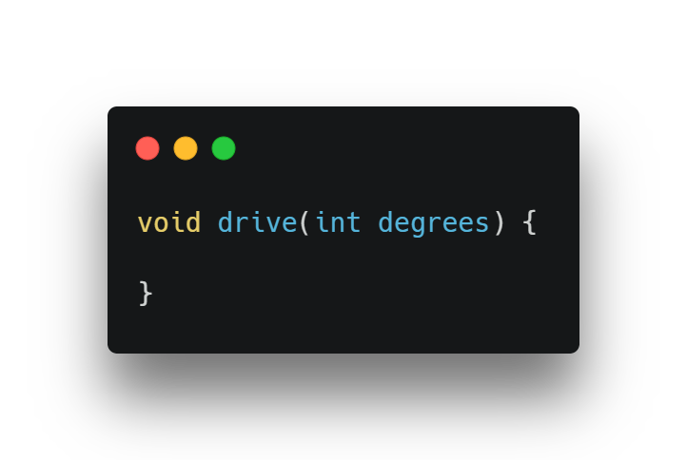
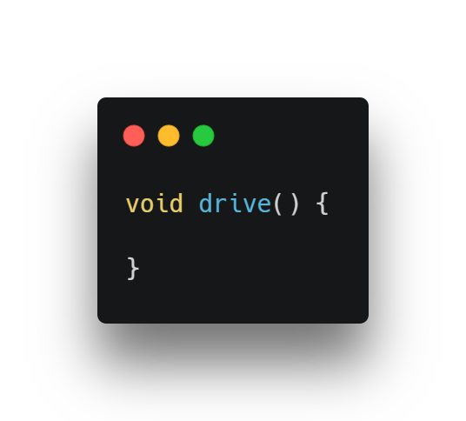
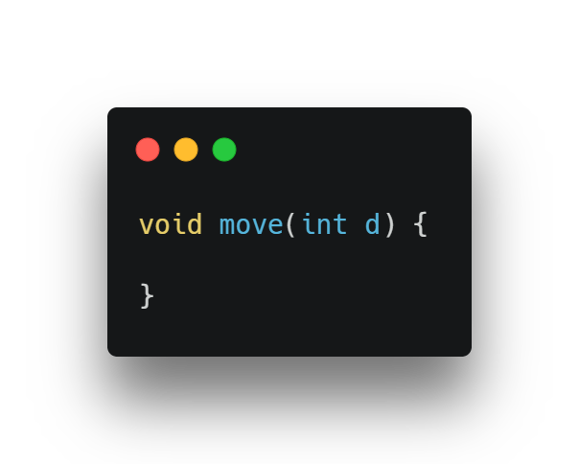
The Code – Creating Our Function
Both #1 and #3 would technically work, but #1 is preferred since it’s more descriptive

Slide 14
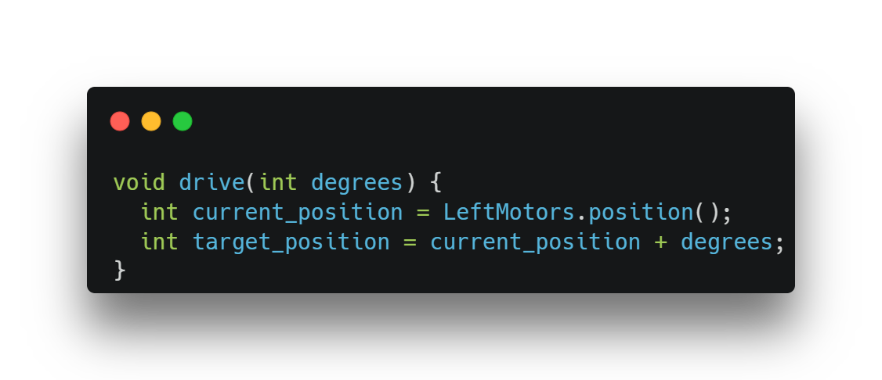
The Code – Getting Our Target
Why are we only getting the position of the left motors? Why does this work?

Slide 15
The Code – Error
Quiz: What is error? A) A mistake the robot makes when it drives B) The difference between our current value and our target value
C) The current rotation value of our motor

Slide 16
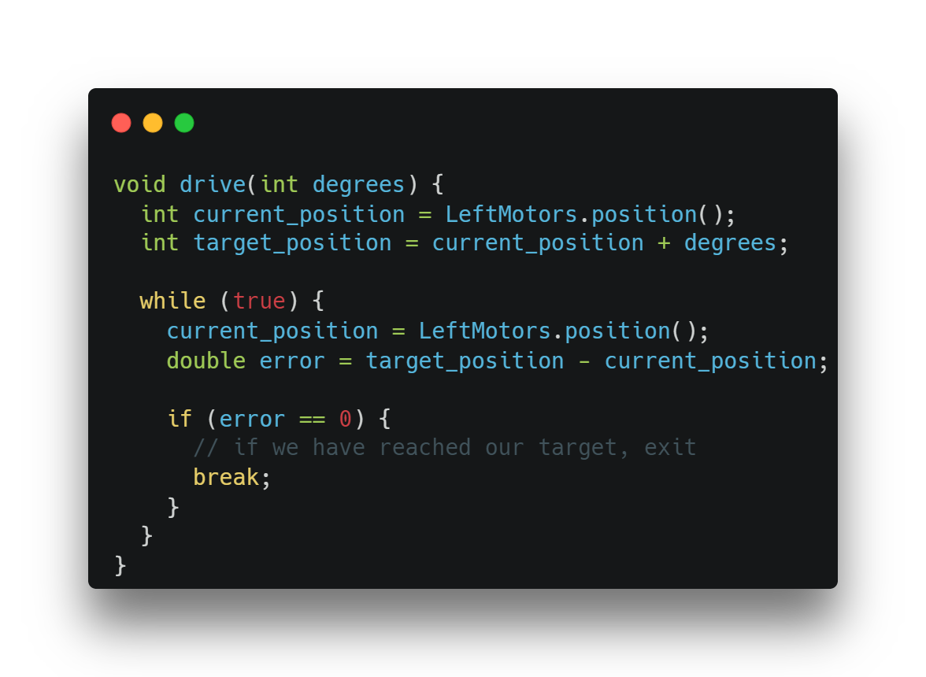
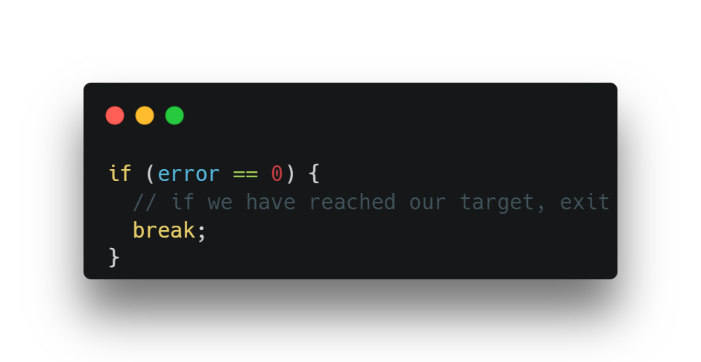
The Code – Measuring Error
Why do we use a loop?
Can you spot any potential problems with this code?
Hint:

Slide 17
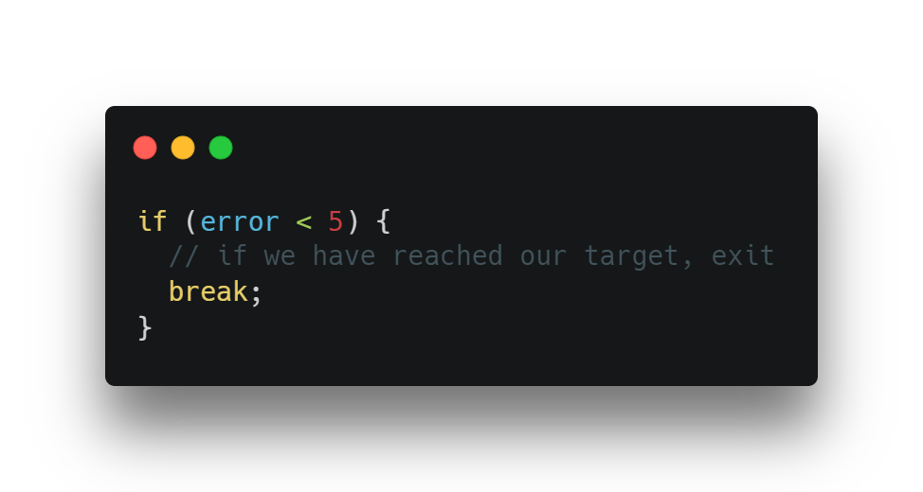
The Code – Error
In the real world, our error will never be exactly zero! To fix this, we can use something called “tolerance”. Tolerance is simple, and it’s basically just a certain amount of error we’re ok with.

Slide 18
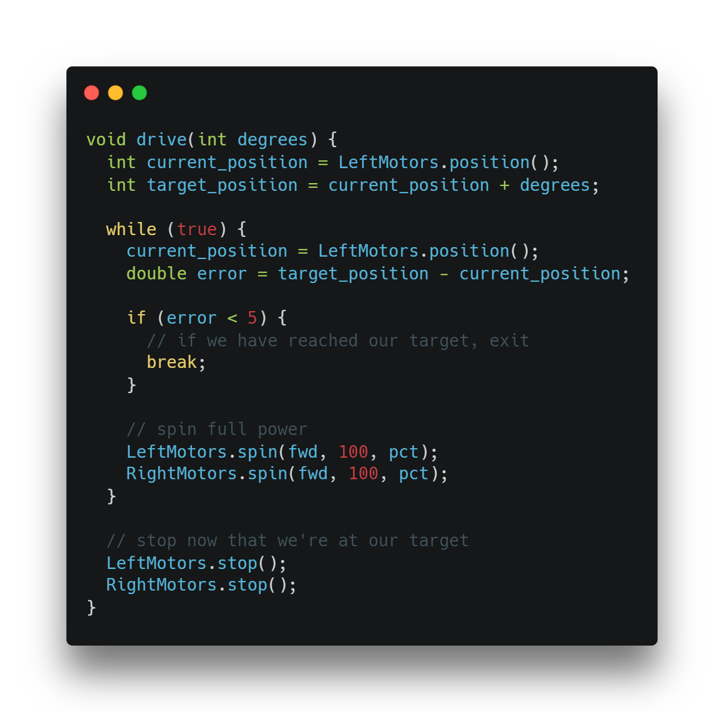
The Code – Moving Motors
We’re now ready to finish up our function! Let’s move our motors.
CHALLENGE: Modify the function so it also takes in a parameter for speed.

Slide 19
Recap!
What is error?
What’s the difference between open-loop and closed loop?
Did we just make an open-loop or closed-loop controller?
Why is that controller better than making the robot drive for a certain amount of time?
What are some problems with the controller we just made?

Slide 20
Slew
Making your robot’s movement fancy

Slide 21
Rate Limiting
Does anyone know what it means to “rate limit” something?
In robotics, rate limiting is the process of limiting how fast something can change. Why would we ever want to do this?
Answer: Physics! Imagine you’re in a car and the driver slams on the brakes. You’ll be pushed forwards hard, and you won’t even stop instantly (although you’ll still stop fast). Just like you’d be a bit startled or injured, your robot could be too. The faster you try to get it to stop, the more “jerk” the robot experiences, and the less accurate the stop will be.

Slide 22
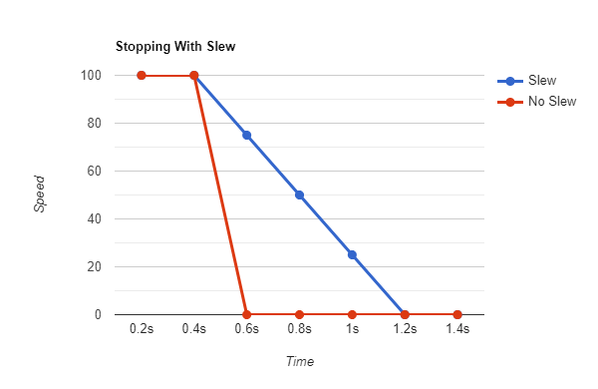
Slew
Slew is a type of rate limiter. It has many practical uses, and my team used it last year to make our drive code smoother.

Slide 23
Making a Slew Function
How does slew work?
We need to set our “limit”. This is known as the slew step
We need to check how much the value we’re limiting has changed
We need to limit the change and return the correct value
Sound confusing? Slew is actually quite simple, and I’ll explain more while we code.

Slide 24
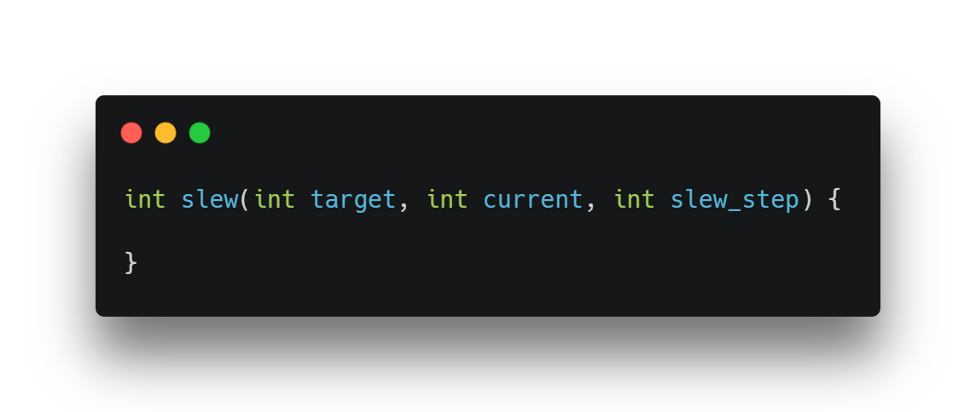
Making a Slew Function
Our slew function will take in our target value, our current value, and our “slew step”. The slew step is just the maximum amount we want to allow our value to change by.

Slide 25
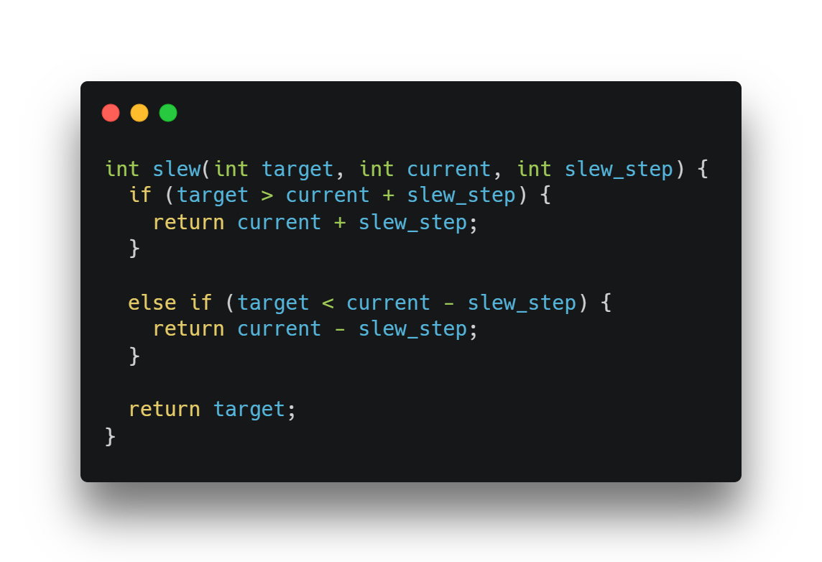
Making a Slew Function
The first if statement checks if our target value is MORE than our current value PLUS our slew step (our slew step is the max our value can increase). If it’s over the max we can increase by, we simply return our current value plus our step.
The second if statement does the same, but it works for negative numbers.
If neither condition is true, it means we are changing by less than our maximum rate of change and we can directly go to our target.

Slide 26
Using Our Slew Function
Let’s test our function by using slew in the controller we made earlier. The controller we made is called a “bang-bang” controller, since it only has two states, ON and OFF.
Challenge: use the function to slow down how fast our controller starts and stops. You will need to keep track of the current percent the motors are at, and you’ll also probably need to change the lines that tell the motors to stop. Good luck!

Slide 27
Recap
What is slew?
Why would we use it?

